Slide 1


Session 8. Enquiries
Transact (T24) Technical Induction Training
Minsk, 2021

Slide 2




Agenda
Enquiry Overview. Enquiry features and types
Default Application Enquiries in T24
Enquiry creation and executing, amending of parameters
Adding Enquiries to User and System Favourites
Drilldowns
Enquiries with Graphic Display: bar chats, pie charts etc.
Fast Path Enquiries
Introduction to ENQUIRY.REPORT
Workshops

Slide 3

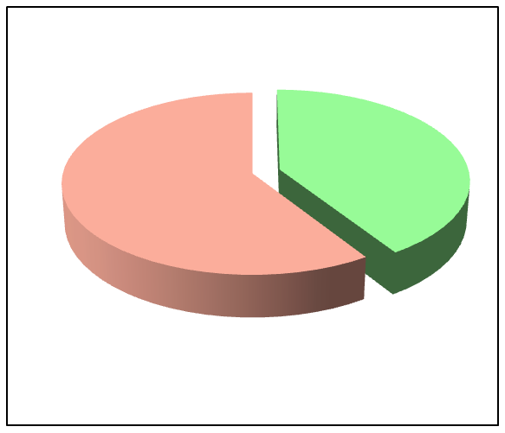
Need for a Reporting Tool
ENQUIRY is a T24 application which allows you to create user defined reports that fetch and display data as per the requirements of the user.
An enquiry is a query that is executed to fetch data from the database and display the results in a user defined format
In technical terms, an enquiry is a ‘SELECT’ executed in order to fetch data from T24 and the results displayed in a user defined format
Transactions
Reporting

Slide 4
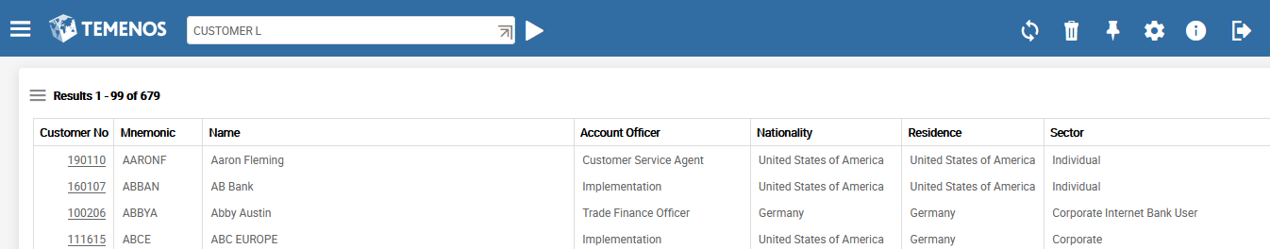
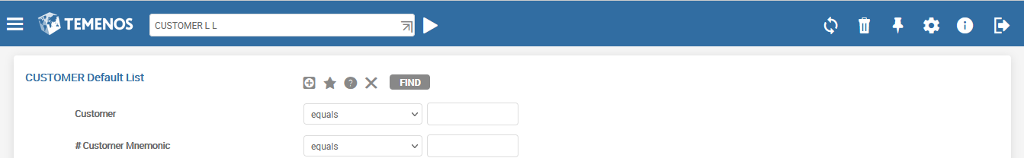
How to view information
To view data from an application , you can do a LIST (L) of all the records:
List all Authorized Records
The LONG LIST (L L) function allows you to specify a selection criteria before the list of records are displayed to you:
List records based on a selection criteria
Notes:
— T24 is made up of different applications like CUSTOMER , ACCOUNT , FUNDS.TRANSFER etc. An application validates and stores the data that is input.
To view data from an application , you can do a LIST (L) of all the records. The LONG LIST (L L) function allows you to specify a selection criteria before the list of records are displayed to you.
However you may use the ENQUIRY application to create reports in user defined formats

Slide 5
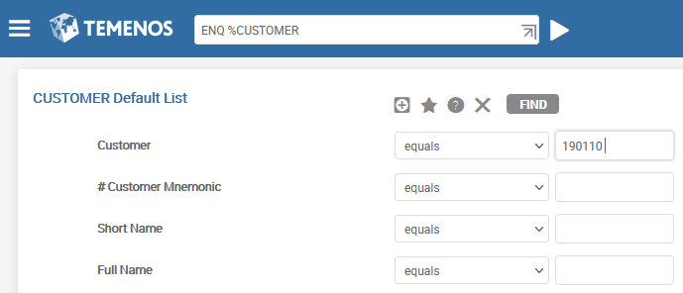
How to view information using an enquiry
ENQ is the command to launch an enquiry. It internally executes ENQUIRY.SELECT which provides the user with a Selection Criterion Screen.
Selection Criterion Window
System defined enquiries start with a %, or have a “–”
Eg: %CUSTOMER, %ACCOUNT, %FUNDS.TRANSFER, %LD.LOANS.AND.DEPOSITS, CURRENCY-LIST, CATEGORY-LIST
These enquiries should not be amended.

Slide 6
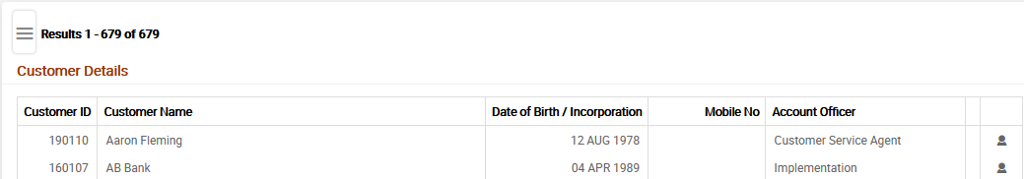
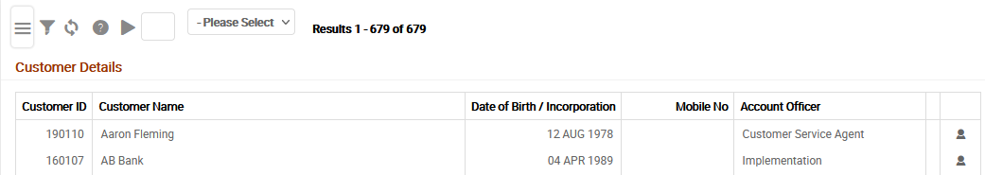
Enquiry - Enquiry Results Display
After you open an enquiry, Results Toolbar (highlighted) displays the options as shown in the following.
Results Toolbar . Single Click
Notes:
Based on the selection criterion specified by the user in the Selection Criterion Screen, the enquiry selects the desired records that match the condition.

Slide 7
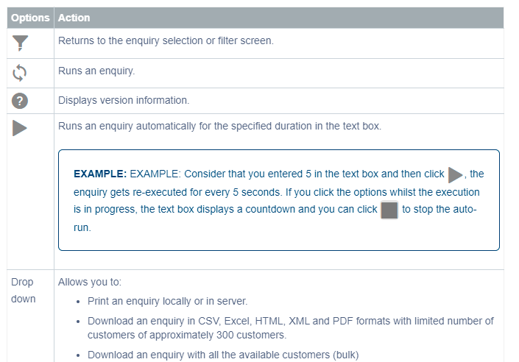
Enquiry - Enquiry Results Display

Slide 8
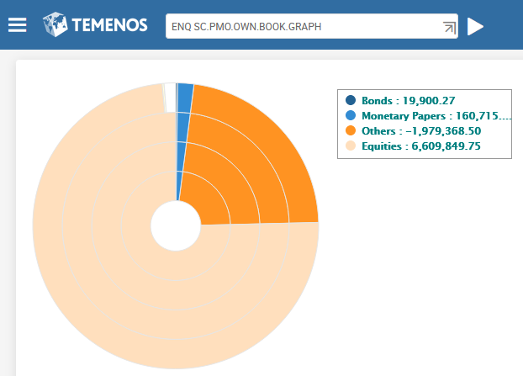
ENQUIRY - Features
Enquiries can display data in various formats like:
Tables
Pie charts
Bar charts
Reports that allow data to be edited not just viewed
Reports with images
Reports with sub totals, grand totals etc.
Enquiries enable user defined subroutines to be attached in order to manipulate selection criteria and field values before they are displayed
Notes:
Pie charts example: Role Based Home pages → Home Page - Treasury Front Office → Securities → Dashboard
ENQ SC.PMO.OWN.BOOK.GRAPH

Slide 9
Default Application Enquiries In T24
T24 provides default application Enquiries. The naming convention for these Enquiries are - %Application name
%ACCOUNT, %CUSTOMER etc.
LONG LIST (L L) function on the command line, internally invokes the built-in Enquiry of T24
The built-in Enquiries can also be modified
Notes:
T24 provides built-in Enquiries. The naming convention for these Enquiries are %Application name.
1.1 Some of the built-in Enquiries are %ACCOUNT,%CUSTOMER, %FUNDS.TRANSFER etc.
When you execute the LONG LIST (L L) function on the command line , internally the T24 system invokes the built-in Enquiry of T24.
However you can also modify these built-in Enquiries.

Slide 10
Demo - Create an Enquiry
Create an Enquiry that displays the ID, Mnemonic, Sector, Nationality and Residence of a customer. Include two headers – “Temenos Training” and “Customer Details”
Notes:
— This task teaches you to create a simple enquiry. The requirement for the task is as follows,
The enquiry is based on the CUSTOMER application. The fields to be part of your enquiry are - @ID, MNEMONIC, SECTOR, NATIONALITY and RESIDENCE .

Slide 11
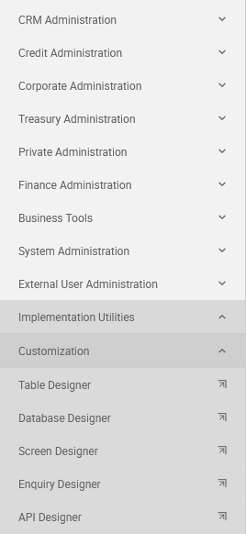
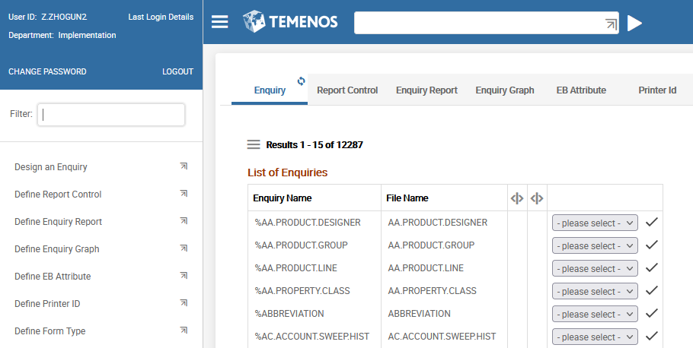
Demo - Create an Enquiry
Executing new version creation or editing existing version:
Menu> Admin Menu> Implementation Utilities>
Customization> Enquiry Designer
STEP 1 – Launch Enquiry Designer from menu (or from Command Line)
Show Menu
STEP 2 – Choose point «Design an Enquiry»
Notes:
— To create an enquiry in T24, create a record in the ENQUIRY application. The ID for your enquiry can be any meaningful alphanumeric text. The only special character allowed is ‘.’

Slide 12
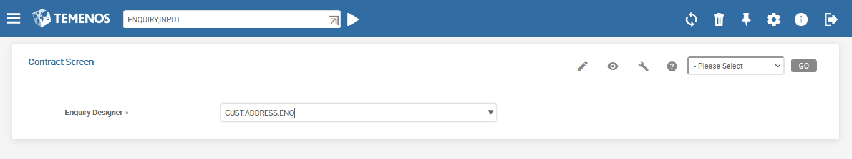
Demo - Create an Enquiry
…or launch Enquiry Designer from Command Line — via command ENQUIRY,INPUT
STEP 3 – Enter the name of the Enquiry
STEP 4 – Push the button «Edit» (in this case it means «Create new record»

Slide 13
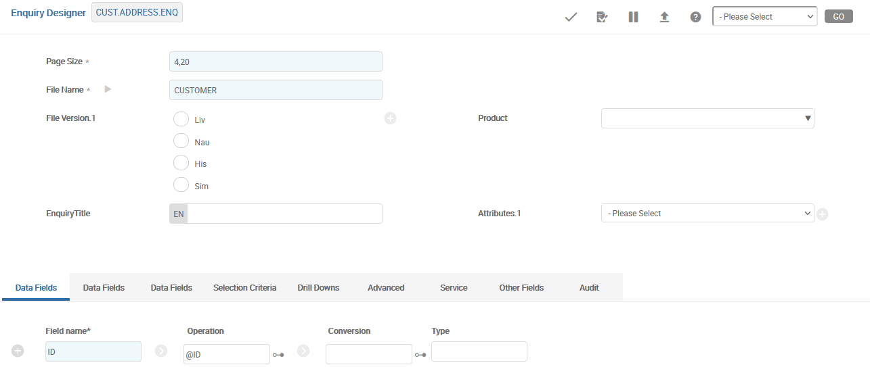
Demo - Create an Enquiry
STEP 5 – Set the Page Size
STEP 6 – Specify the Table to query
Notes:
— Before designing an enquiry, decide on the page layout. Does your report have a header? How many lines can be displayed per page of the report? The first field PAGE.SIZE allows you to do this. Specify the number of lines for the header and number of lines for the body of the report separated by a comma. In this example four lines are allocated for the header and twenty lines are allocated for the report.
Enquiries are created to query and select data from tables. Specify the table (file) to be queried in the field FILE.NAME. In the example the enquiry is created for the CUSTOMER application.
«Table name» is the application name itself as there exists one table behind every application which has the same name as the application name.

Slide 14
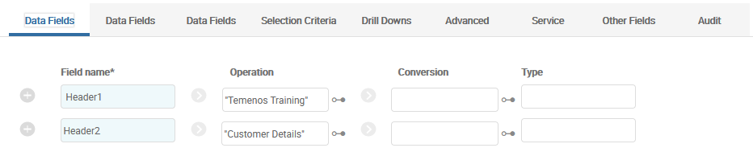
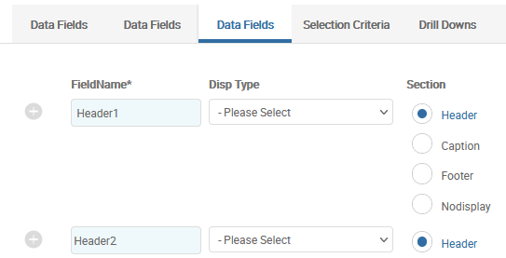
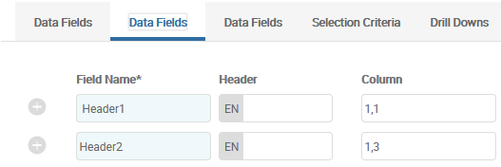
Demo - Create an Enquiry
STEP 7 – Set the Header Information: on all 3 tabs
Filling 3-rd tab:
Filling 2-nd tab:
Notes:
— Specify the Header Information as shown.
FIELD.NAME is an associated multi-value set used to display header lines. The text to be displayed as column heading is specified in the OPERATION field. The value specified in FIELD.NAME is not the one which is displayed.
Specify the first line of the header as “Temenos Training” . The text to be displayed as header should be enclosed within quotes.
Use the COLUMN field, to specify the position of header text – column and row details. The first value represents the column and the second value represents the row. The two values are separated by a comma.
Use SECTION field to specify where the header has to be displayed. Choose HEADER.

Slide 15
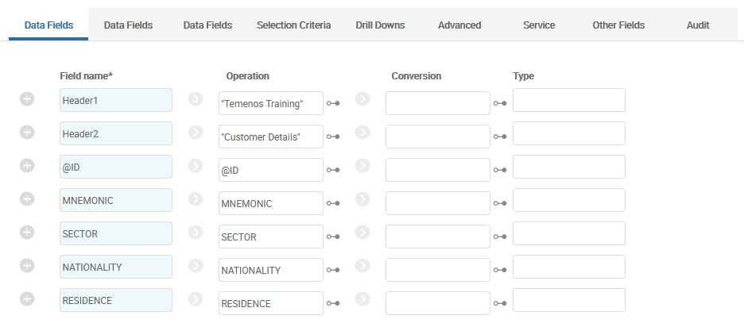
Demo - Create an Enquiry
STEP 8 – configure the fields required in the report: on all 2 tabs
Notes:
— Each column in the report is an extracted field from the application. Each column must have a header that represents what data is being displayed. This header is mentioned in the field FIELD.NAME. The OPERATION field holds the actual name of the field in the table. Data is fetched from this field from the table and populated in the enquiry.
(If you specify the actual field name from the STANDARD.SELECTION in the field FIELD.NAME, this value is defaulted in the OPERATION field too during Validation. This saves you some time during enquiry creation. If you desire a user-defined column heading, give a different label in the field FIELD.NAME, but the OPERATION field will not be auto-populated)

Slide 16
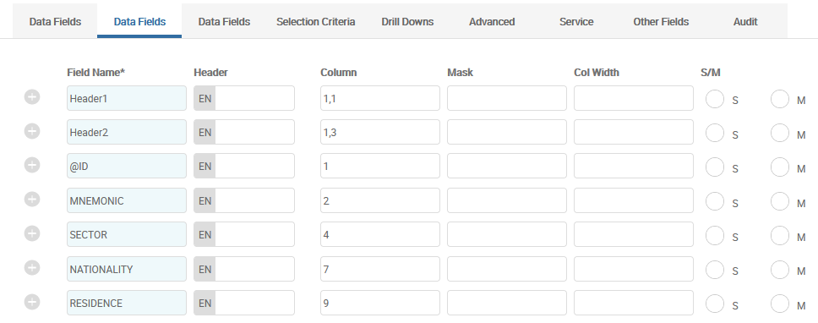
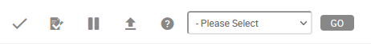
Demo - Create an Enquiry
Filling 2-nd tab:
STEP 9 – Authorize the record
Notes:
— Specify the order for the fields to appear in the enquiry in the COLUMN field. The first field @ID is displayed in column one. If COLUMN is left blank, the column will not be displayed as part of the report.
Note: Columns must always be specified in the correct order, meaning from left to right. The ENQUIRY application cannot display the output correctly if the columns are all mixed up.
Value for the LENGTH.MASK field is defaulted by T24. You can adjust the length and justification of the field using the LENGTH.MASK field . Also the value in the field SINGLE.MULTI is defaulted by T24 depending on the nature of the field. This field can hold the value S or M.

Slide 17
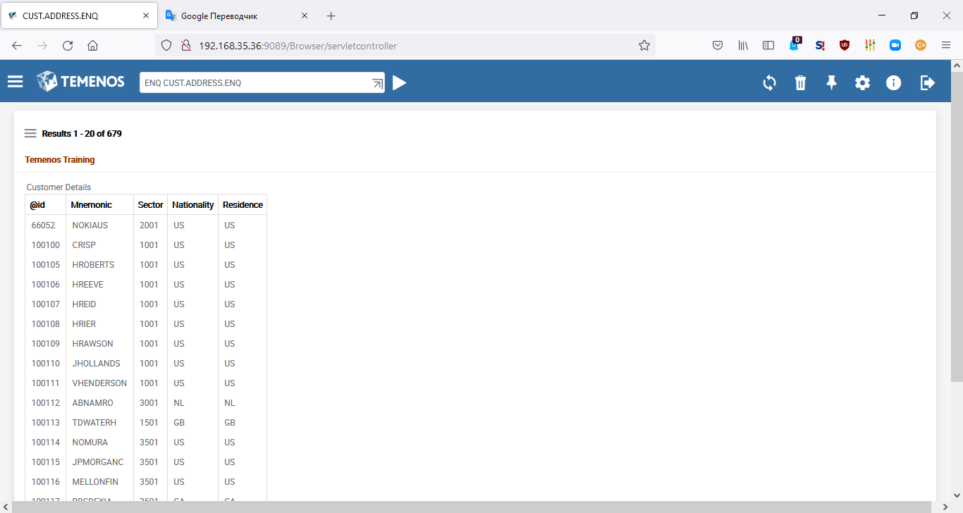
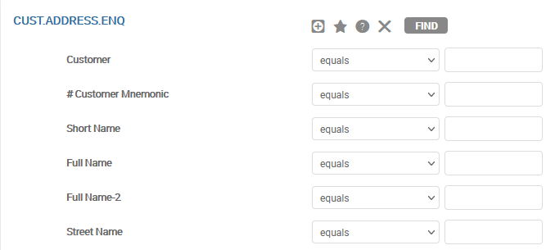
Demo – Execute the Enquiry
ENQ CUST.ADDRESS.ENQ SECTOR EQ 1001
Selection Criteria Box
Notes:
— Execute the enquiry to view the output. Use the command ENQ followed by the enquiry (name) ID at the command line. ENQ is the abbreviation for ENQUIRY.SELECT application.
The enquiry will display all the records against the 5 fields specified earlier, page by page. That is, by default, any enquiry is T24 displays all records from the application the enquiry is based on.
You may also specify conditions at runtime in an enquiry. Based on the values supplied by the user, the enquiry will filter the records and only select those which satisfy the condition.
When you execute the enquiry, a Dynamic Selection Criteria box appears. This allows you to specify run time selection criteria based on all fields of the application the enquiry is based on. You may specify one or more conditions in the selection criteria box to filter out specific records from the database. The format of the criteria is <Fieldname> <Logical Operand> <Value>. When you specify multiple conditions, there is a logical AND between them. Then click on the Find button to execute your enquiry. You will see that you can specify a selection criteria on any field of the CUSTOMER application. The list of fields displayed here matches the list of fields in the STANDARD.SELECTION record for the CUSTOMER application.
Another way of specifying the selection criteria at runtime is while executing the enquiry itself. ENQ CUST.ADDRESS.ENQ SECTOR EQ 1001
The same format could be used in HELPTXT.MENU
To launch Enquiry with no parameters you could use QUERY instead of ENQ. Selection Screen will be skipped.

Slide 18
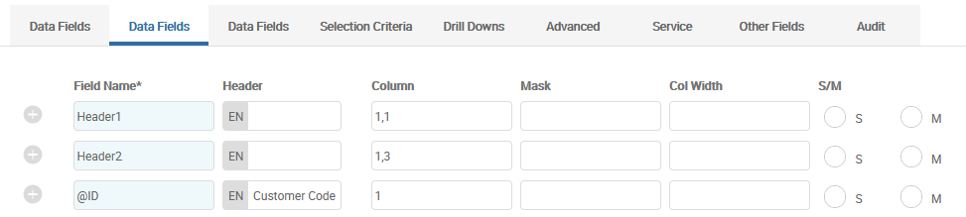
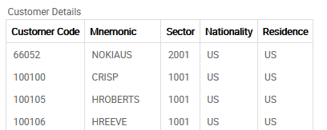
Customise Column Headings
User Defined Column Headings
User Defined Column Headings
Notes:
— Header for a field is specified in the field «Header» (FIELD.LBL) on 2-nd tab. Header for the @ID field is specified as ‘Customer Code’. If this field is left blank, value in FIELD.NAME field will be defaulted.
Authorise your enquiry record and execute to view the results. Ensure that you specify COLUMN value for all the fields.

Slide 19
Workshop - 1
TASK 1 –
Create an enquiry based on the ACCOUNT application in T24 which lists the following fields:
@ID (Account ID), MNEMONIC, CURRENCY, CATEGORY and WORKING.BALANCE.
Display meaningful column headings in your enquiry
The enquiry should display the following as Header –
Temenos Training
Default Account List
TASK 2 –
Execute the Enquiry to generate the report of accounts with CATEGORY 1001
Notes:
— This is the workshop section of the learning unit.
Create a report based on the ACCOUNT application in T24 which lists the following fields
2. @ID (Account ID), MNEMONIC, CURRENCY, CATEGORY and WORKING.BALANCE
3. Display meaningful column headings in your enquiry
4. Execute the Enquiry to generate the report of customers who belong to SECTOR (One thousand and one) 1001

Slide 20
Parameterized Enquiries
Create a report based on the CUSTOMER application in T24 which lists the following fields:
@ID (Customer ID), MNEMONIC, SECTOR, NATIONALITY and RESIDENCE
Only customers with nationality US need to be displayed
Value for SECTOR should be made a mandatory input at runtime
Notes:
— This task teaches you to specify fixed selections and dynamic selection criteria in enquiries. Consider a scenario where a bank decides to provide an offer for the US customers who belong to a particular SECTOR .The SECTOR is specified at run time. How will you create an enquiry for the given requirement?
Create a report based on the CUSTOMER application in T24.
The fields to be displayed are @ID (Customer ID), MNEMONIC, SECTOR, NATIONALITY and RESIDENCE.
Display only those customer records whose nationality is US
The Value for the field SECTOR need to be obtained from the user at run time. Make this as a mandatory input.

Slide 21
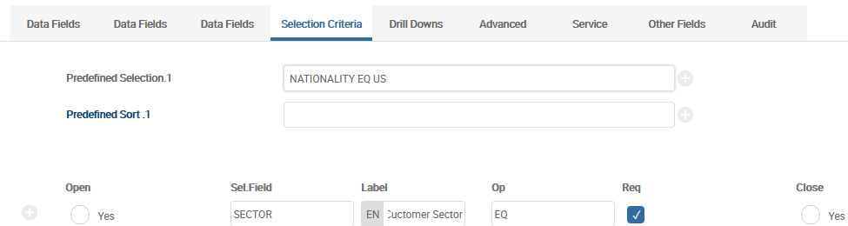
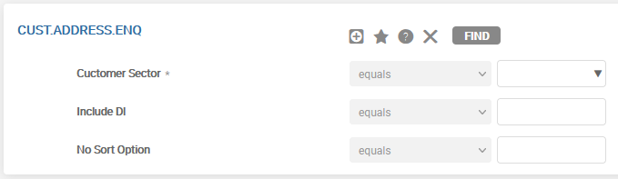
Demo - Fixed & Dynamic Selection Criteria
Fixed Selection executed first and always before Dynamic Selection
Makes Sector Mandatory user Input
* - Denotes mandatory selection field
Fixed Selection always executed first followed by Dynamic Selection
Notes:
— You need to design a report which only display information of customers whose nationality is US. Since this requirement is fixed, specify it in FIXED.SELECTION field. More than one fixed condition can be specified, if required by a logical AND between the multiple conditions. The condition specified in fixed selection will be executed first and always before dynamic selection. It first filters records with nationality equal to US, and then applies the dynamic conditions specified at runtime on these filtered records. User does not have privileges to modify this condition during execution.
The format of FIXED.SELECTION is FIELD.NAME <space>operand <space> value. The required condition for this example is ‘NATIONALITY EQ US', where NATIONALITY is a field name and EQ is the operand. The fixed selections are always executed first, before the dynamic run time selection criteria that is entered.
To make SECTOR as a mandatory dynamic selection criteria input, use the field SELECTION.FLDS. To change the label of the field that is displayed in the dynamic selection criteria, use SEL.LABEL. This multi-value set also allows you to impose restrictions on the operand to be used in the dynamic selection criteria using the SEL.FLD.OPER (Selection Field Operand). Multiple operands can be provided in this field ,delimited by space. Set the field REQUIRED.SEL to Y to make the field mandatory at runtime. The enquiry will not execute till a value is provided for SECTOR in the dynamic selection criteria box.
You will notice that unlike the last task, when you use these set of fields, only the application fields configured here are displayed during run-time in the dynamic selection criteria box.

Slide 22
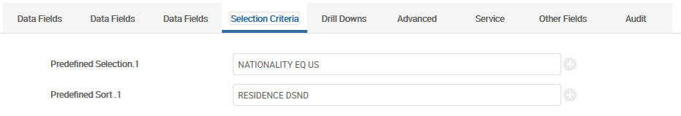
Sorted Records
Specify the name of the field to be sorted and the direction of sorting
Predefined Sort — Specifies the fixed sort field names.
This specifies the dictionary field names for the primary sort which will be performed with the users selection criteria. A descending sort can be specified by entering 'DSND' after the sort fieldname.
Examples: CUSTOMER - Ascending sort by customer.
ACCOUNT DSND - Descending sort by Account number.
Notes:
To sort records in the descending order of their MNEMONIC, USE the field FIXED.SORT field in the ENQUIRY application
FIXED.SORT- This field is used to specify fixed sorts for enquiry. Specify the name of the field that has to be sorted. By default the system sorts in ascending order. To sort the records in descending order specify DSND along with the field name.

Slide 23
Workshop - 2
Amend your earlier created enquiry to ensure data that meets the following condition alone is retrieved from the database:
Either the value for currency has to be supplied OR the value for category has to be supplied (values should be made a mandatory input at runtime)
and
Account should be a customer account (No internal accounts)
Sort the records in the descending order of the value in the WORKING.BALANCE field
Hint : Internal accounts do not have a value in the field CUSTOMER (CUSTOMER NE “”)
Notes:
. Amend the enquiry to ensure data that meets the following condition alone is retrieved from the database.
2. Either the value for currency has to be supplied or the value for category has to be supplied And
3. Account should be a valid customer account.
Hint : Internal accounts do not have a value in the field CUSTOMER

Slide 24
OPERATION field
Operation field
FIELD.NAME | Dynamically locates the field reference by using FILE.NAME's STANDARD.SELECTION record.
FIELD.NO | Field reference in Numeric format. (0 - ID) (Not recommended only use in cases where the (1-999) record is built by a routine and does not follow the layout of the file used - see USE.FIELD.NUMBERS)
IDESC XXX | Execute the I-descriptor defined in the STANDARD.SELECTION record of the FILE, as a Type I or J item, with the FIELD.NAME XXX. The result is returned in the same way as if the field was extracted from the record.
SELECTION XXX | Return the value of the SELECTION.FIELD XXX entered in the selection criteria.
FIELD XXX | Extract current value of enquiry field XXX.
TOTAL XXX | Total enquiry field XXX.
BREAK CHANGE XXX | Break on change of enquiry field XXX.
BREAK LINE NN | Break when line NN has been exceeded.

Slide 25
OPERATION field
CALC XXX + YYY | Add enquiry field XXX and YYY.
CALC XXX / YYY | Divide enquiry field XXX by enquiry field YYY.
CALC XXX * YYY | Multiply two enquiry fields.
CALC XXX - YYY | Subtract two enquiry fields.
CALC XXX : YYY | Concatenate two enquiry fields.
IF AA GT BB XXX YYY | Decision process. If enquiry field AA is greater than enquiry field BB then process enquiry field XXX or process enquiry field YYY and return the value to this enquiry field. The valid operands are EQ, NE, GT, LT, GE, LE, RG, NR, LK, UL. Field is Subvalued to allow the decision criteria to span more than a single line for clarity.
"zzzzz" | Use the constant contained in quotes.
!USER | Extract current user id.
!TODAY | Extract todays date.
!SYSTEM.DATE | Extract system date.
!COMPANY | Extract current company id.
!LANGUAGE | Extract user's language code.
!LOCAL.CCY | Extract local currency code.
!LAST.WORKING.DAY | Extract last working day.
!NEXT.WORKING.DAY | Extract next working day.

Slide 26
CONVERSION field
Conversion field
FIELD X,N1,N2 | Extract from the data, delimited by X, the N1th field to the N2th
EXTRACT N1,N2 | Extract from the data starting at position N1 for N2 bytes
SUBSTITUTE X,Y | If the data equals X then replace it with Y.
CONVERT X,Y | Replace every occurrence of the character X with Y.
VALUE X,Y | Extract value X, sub-value Y from the data.
LINK XXX,YYY | Read file XXX using the current data as the key and return field name YYY as defined in the STANDARD.SELECTION record for XXX. Do not specify F. or company mnemonic in file name. Field Name YYY may be a data field or an I or J descriptor defined in the Standard Selection record of file XXX Note that if a multi or sub valued item is returned from a LINK conversion, the multi and sub values are converted to spaces, so the result cannot be displayed in separate lines.
UTIL ABS | Return the Absolute value of an amount.
Notes:
This is not all functions of CONVERSION field, for full list please see Helptext.

Slide 27
Demo – Passing Data from Enquiry to Version
Create an Enquiry based on the CUSTOMER application and display the following fields: @ID and SHORT.NAME
Using this Enquiry invoke a Version that creates Account for the Customers
Can you invoke a Version from an Enquiry?
The ENQUIRY application in T24 allows you to invoke the other applications.
This is known as Drilldown.

Slide 28
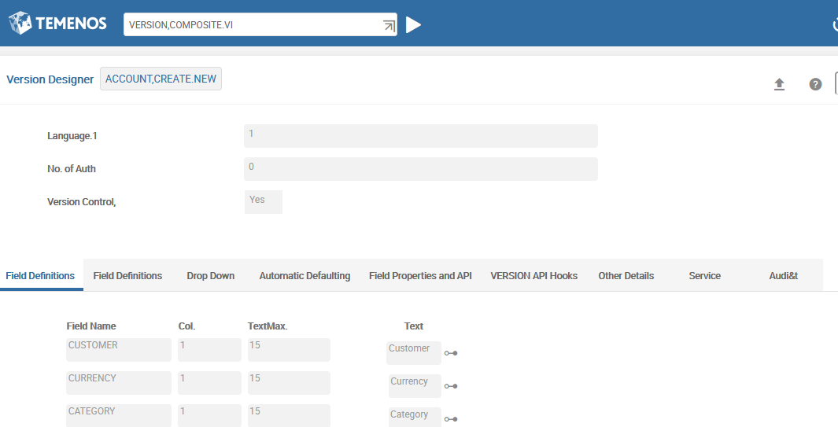
Demo – Passing Data from Enquiry to Version
Create new version
Notes:
You must first create the Version and Enquiry records that need to be part of the workflow.

Slide 29
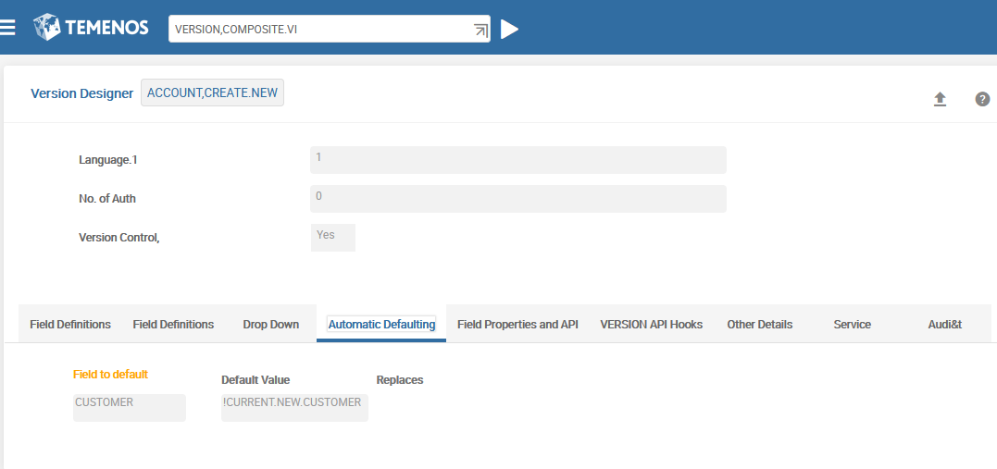
Demo – Passing Data from Enquiry to Version
!CURRENT.NEW.CUSTOMER is а variable. It should start with «CURRENT»
We will fill this variable in Enquiry
Notes:
The task requires that values from the enquiry to be passed to the fields in the version. The value for the field ID is passed to the version from the enquiry. Therefore these fields will be populated automatically once you launch this version.
AUTOM.FIELD.NO – In this field you specify the field name for which you want to default the values.
AUT.NEW.CONTENT – The field AUT.NEW.CONTENT holds the value to be defaulted. Here as you are passing the value from the enquiry, specify the content in the following format APPLICATIONNAME>FIELDNAME.

Slide 30
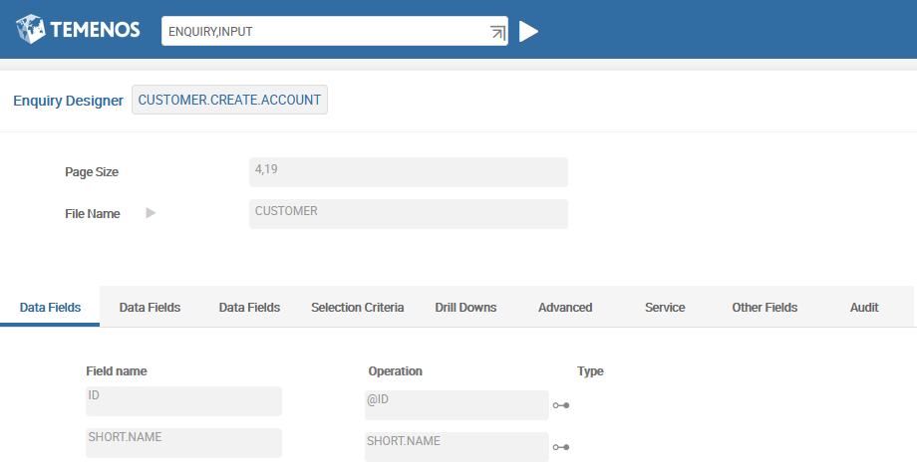
Demo – Passing Data from Enquiry to Version
Create new enquiry
Notes:
You must first create the Version and Enquiry records that need to be part of the workflow.

Slide 31
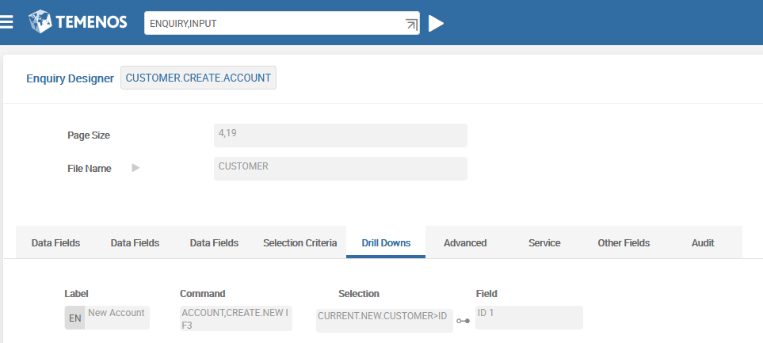
Demo – Passing Data from Enquiry to Version
We invoke Version with operation I (Input) and F3 (generate new ID)
If we want to open existing record, instead of F3 could be name of the field from this Enquiry. So, Version will use content of this field.
!CURRENT.NEW.CUSTOMER is а variable. It should start with «CURRENT»
We fill this variable in Enquiry and will read it in Version
ID is the field from this Enquiry. The variable will be filled by content from this field.
Notes:
The task requires that values from the enquiry to be passed to the fields in the version. The value for the field ID is passed to the version from the enquiry. Therefore these fields will be populated automatically once you launch this version.
ENQUIRY.NAME – In this field you can specify an enquiry or an application name that will be invoked next. You can specify the function followed by the application name. To invoke an application in SEE mode you can append the function ‘S’ along with the application. As you are going to invoke a version that will create customer accounts, specify ACCOUNT,TRG.VERSION1 I F3. ACCOUNT,TRG.VERSION1 is the version to be invoked. F3 is specified for auto-id generation.
SEL.CRIT - The customer ID should be automatically populated in the Account record. You can pass the Customer ID by specifying the field name in the field SEL.CRIT. The format is Application name>Field name. Field name should be defined in this enquiry. In this field you will mention CUSTOMER > CUSTOMER.NUMBER , where CUSTOMER.NUMBER is the field name for @ID field in this Enquiry.
LABEL.FIELD – The field in the enquiry whose value is passed to the version must be mentioned in this field.
Note: The number in the screen shot next to the value CUSTOMER.NUMBER defaults when the enquiry record is committed. It denotes the position of that field in the enquiry.
The text that acts as a hyper link is specified in the field NXT.DESC.
Now authorize and execute your enquiry.

Slide 32
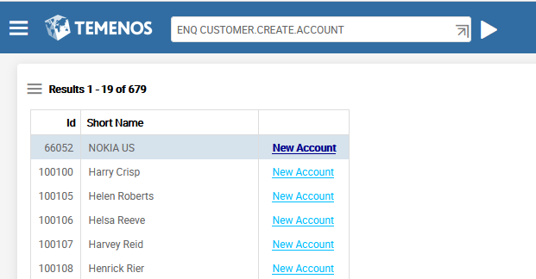
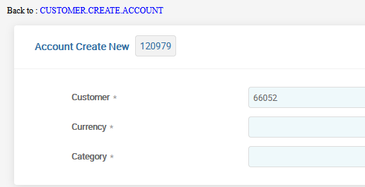
Demo – Passing Data from Enquiry to Version
Single click to invoke Version

Slide 33
Demo – Passing Data from Enquiry to Enquiry
Another type of Drilldown is link to another Enquiry
Create an Enquiry based on the ACCOUNT application invoke it from Enquiry based on CUSTOMER
New Enquiry should show an Account list of chosen Customer.
Customer ID should be passed from parent Enquiry to child Enquiry

Slide 34
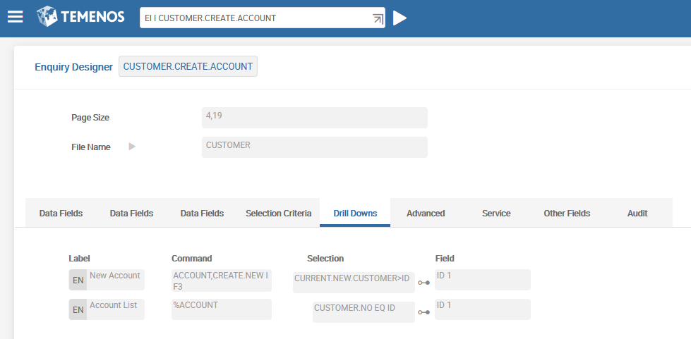
Demo – Passing Data from Enquiry to Enquiry
ID of Child Enquiry
Selection Field in the child Enquiry
Field from parent Enquiry

Slide 35
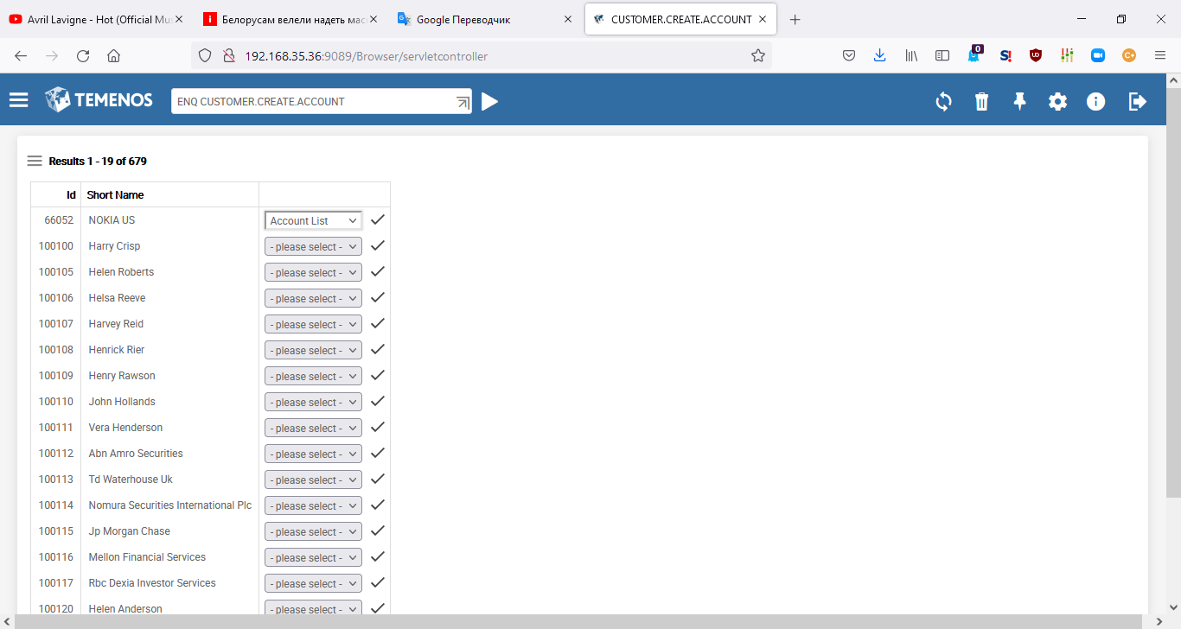
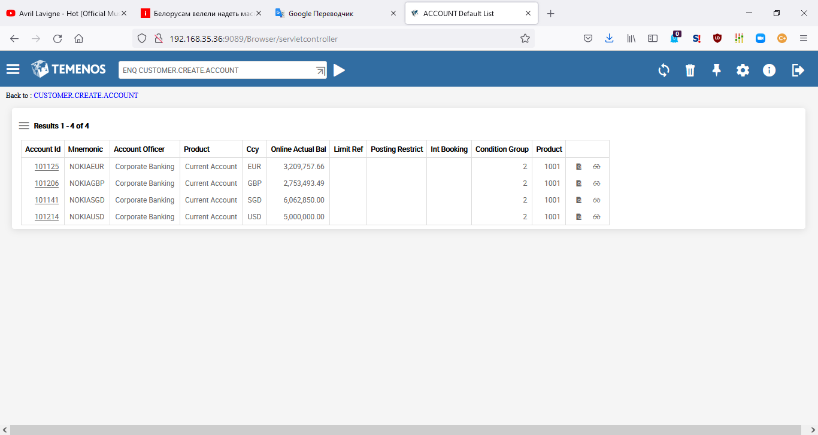
Demo – Passing Data from Enquiry to Enquiry
Single Click
Account List for chosen customer
Choose variant from dropdown list

Slide 36
Workshop - 3
Create an Enquiry based on the ACCOUNT application and display the following fields:
CUSTOMER, MNEMONIC, CATEGORY and CURRENCY
Create an Enquiry based on the FUNDS.TRANSFER application which displays the following fields:
TRANSACTION.TYPE, DEBIT.ACCT.NO, DEBIT.CURRENCY, DEBIT.AMOUNT, CREDIT.ACCT.NO and CREDIT.CURRENCY
The user should be able to view the FT details of a particular account from the account enquiry: View Debit Details (FT field DEBIT.ACCT.NO) and View Credit Details (FT field CREDIT.ACCT.NO)
Notes:
The given workshop tests your understanding on drilldown enquiries. The requirement is stated below:
Create an Enquiry based on the ACCOUNT application and display the following fields – CUSTOMER,MNEMONIC,CATEGORY & CURRENCY
Create an Enquiry based on the FUNDS.TRANSFER application which displays the following fields – TRANSACTION.TYPE, DEBIT.ACCT.NO, DEBIT.CURRENCY, DEBIT.AMOUNT, CREDIT.ACCT.NO, and CREDIT.AURRENCY
The user should be able to view the FT details of a particular account from the account enquiry

Slide 37
Context Enquiries
Enquiries may be launched as Context Enquiries. They supply the ENQUIRY with context sensitive data obtained from the contract currently being edited, replacing the need to specify ENQUIRY selection criteria via the ENQUIRY selection screen
Context Enquiries are defined using the CONTEXT.ENQUIRY application. This application is used to define enquiries that are linked either to applications, versions or specific fields within applications or versions:

Slide 38
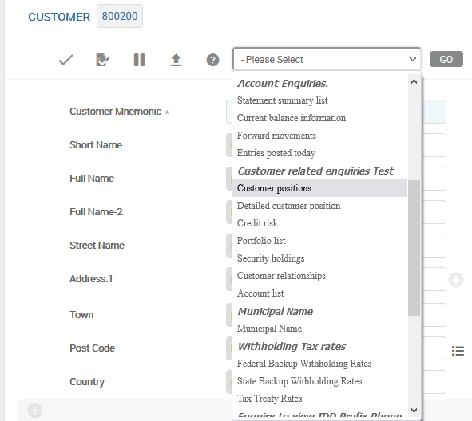
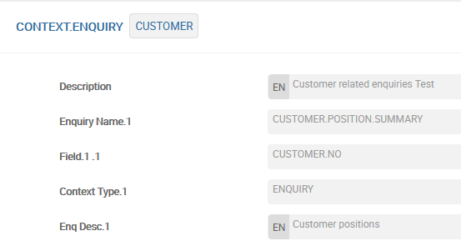
Context Enquiries
If a Context-sensitive ENQUIRY is linked to a file using the CONTEXT.ENQUIRY application, it appears in the drop-down ‘ENQUIRY’ menu and can be selected from there. When launched, the results of the ENQUIRY will be displayed in a separate window:
Name of application
Selection Field from Enquery. It will be filled by record ID

Slide 39
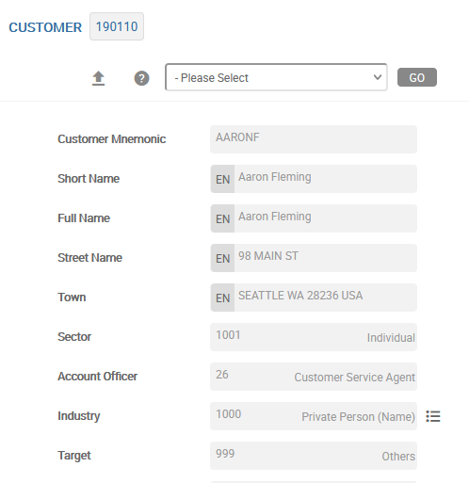
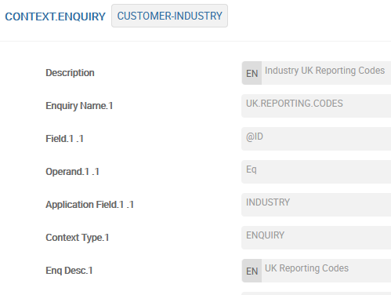
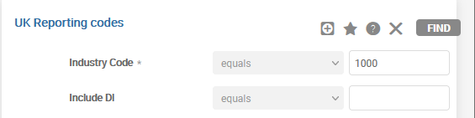
Context Enquiries
Where a file name (and optionally version) and a field is specified in the record ID of CONTEXT.ENQUIRY application, then this record pertains to the context sensitive enquiries that are available for the field:
Application name
Field name

Slide 40
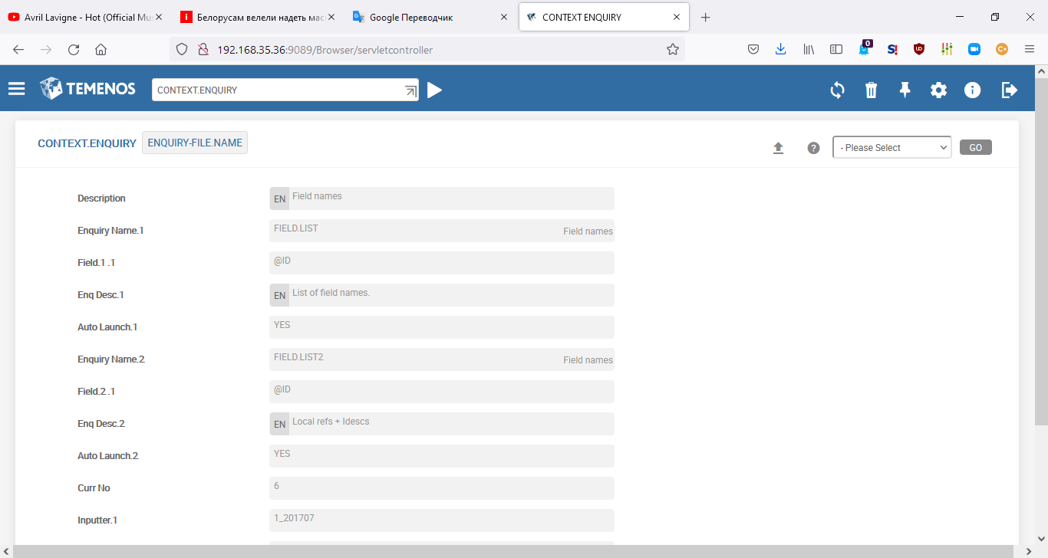
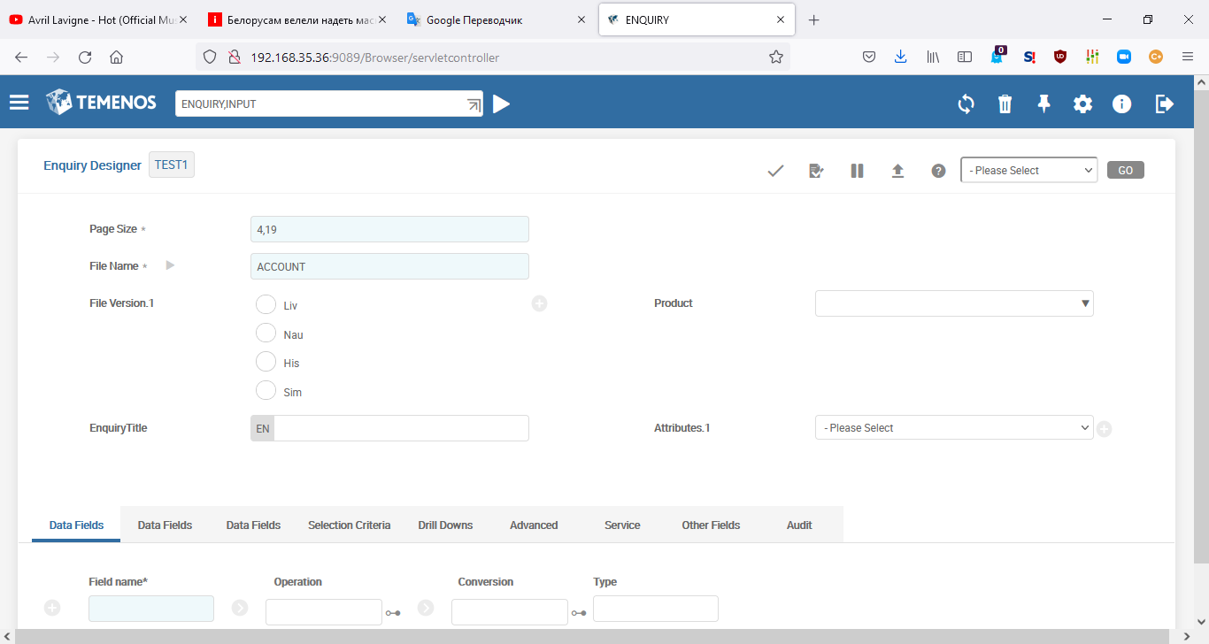
Auto-launching Context Enquiries
Fields that have Auto-Launching context enquiries have an icon next to them:

Slide 41
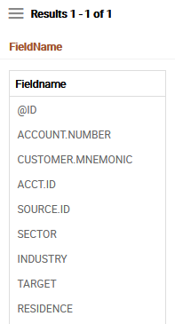
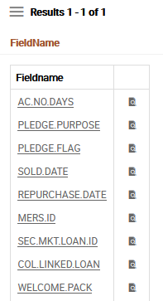
Auto-launching Context Enquiries
Context Enquiries can be set up to auto-launch another ENQUIRY, application or version when triggered. These Context Enquiries may be triggered in a number of ways: by opening a particular application, version or ENQUIRY, by entering information on a particular field, or by committing a contract:
If user fill this field, two enquiries invokes

Slide 42
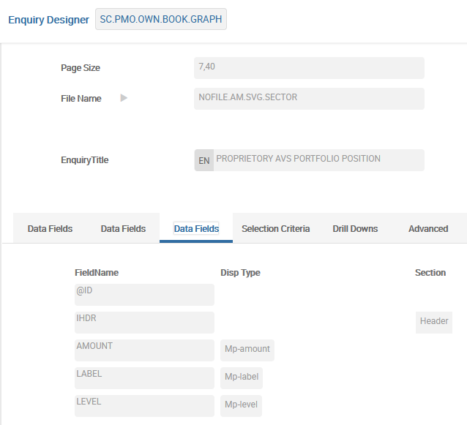
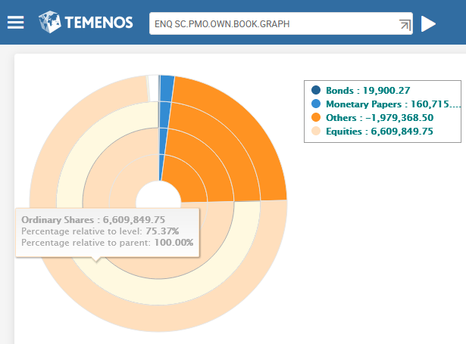
Enquiries with Graphic Display
Except Enquiries with Table Display of data, there is possibility to create Enquiries with different Graphic Display of data.
Form of data display
Amount is reflected while point at the sector
Notes:
Pie charts example: Role Based Home pages → Home Page - Treasury Front Office → Securities → Dashboard
ENQ SC.PMO.OWN.BOOK.GRAPH

Slide 43
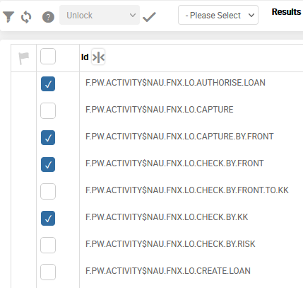
Fast Path Enquiries
Т24 has possibility to create Enquiries with Fast Path function: this function allows user to select different records displayed in formed list of Enquiry, and pushing one time the special button – make chosen operation for all selected records:
Authorize
Delete
Verify etc.
Operation result is reflected in icon of «Status» of each
Record in the Enquiry list – displaying success or not of
Operation for each record.
Text information about the operation result is reflected
as a Tooltip.

Slide 44
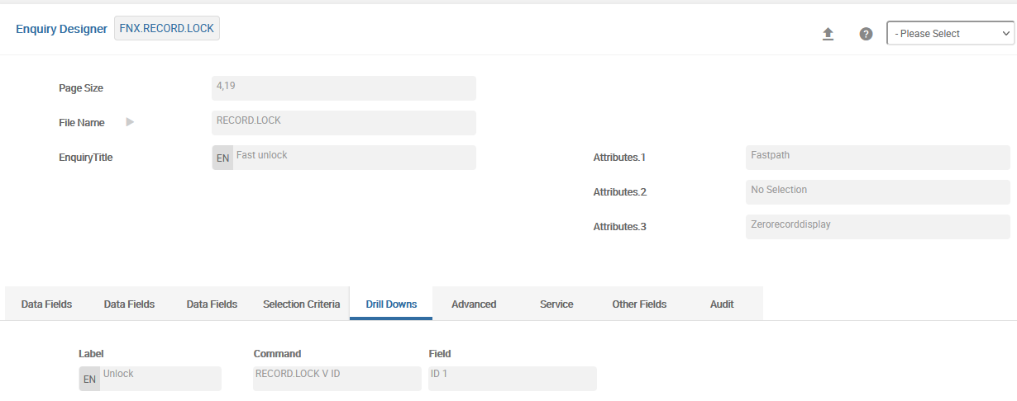
Fast Path Enquiries

Slide 45
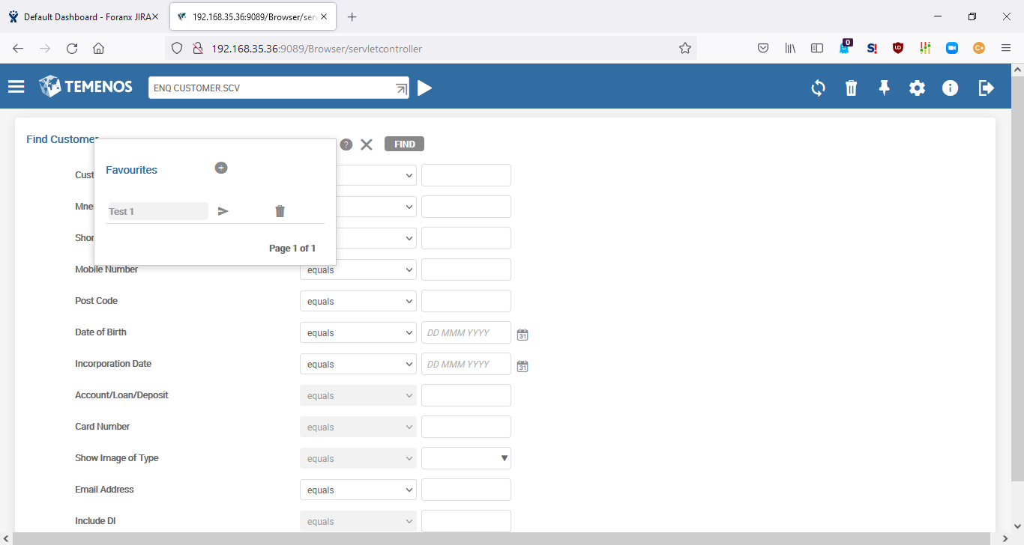
Setting Favourites for Enquiries
The application EB.SELECTION.FAVOURITES in T24 allows users to save selection criteria in enquiries as favorites.
Depending on the structure of the record ID these saved records can be system wide (when ID = ENQUIRY) or available to specific users (ID will also contain USER).
Set ATTRIBUTES field in ENQUIRY to NO.ENQUIRY.FAVOURITES to disable favourites
After entering values into the selection fields, it is possible to remember them using icon.
You can execute the previous selection values by clicking icon.
You can click to remove the favourites permanently.
You can click add a new favourite with the specified name. All the current selection fields are stored for execution in the future.
Notes:
The application EB.SELECTION.FAVOURITES can be utilized by the user and system administrators. This is to save specific enquiries based on selection criteria as favourite enquiries.
2. Depending on the structure of the record ID these saved records can be system wide (available to everyone) or available to specific users.
If a favourite for an enquiry is not required it can be disabled by setting the ATTRIBUTES field in ENQUIRY as NO.ENQUIRY.FAVOURITES.
If this is set then the favourites do not appear when executing the enquiry.

Slide 46
Introduction to ENQUIRY.REPORT
For cases when it is necessary to upload a significant amount of data through a request, T24 provides a mechanism for generating reports on date/regulations through the ENQUIRY.REPORT application. In this case the query algorithm can work at a certain time (for example, at COB), and the result of its work will be saved and available at any time later.
Generally prepared as part of batch run
Generated and stored for pre-defined periods and / or printed
Daily General Ledger, Weekly report on over-dues, Monthly report to Central Bank

Slide 47
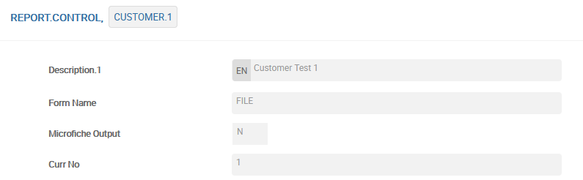
Introduction to ENQUIRY.REPORT
In REPORT.CONTROL application general settings of the report are defined:
Resulted file will be created in &HOLD& folder.

Slide 48
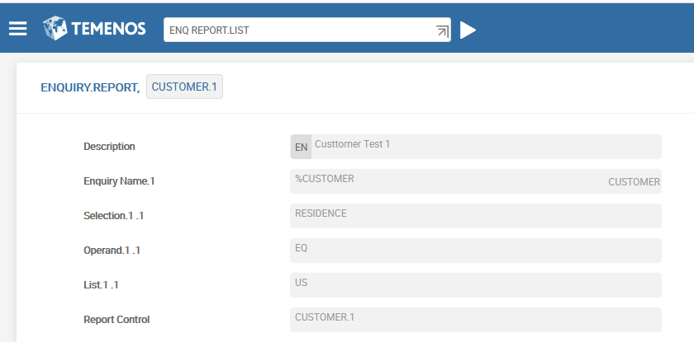
Introduction to ENQUIRY.REPORT
In ENQUIRY.REPORT application Enquiry name and selection criteria are defined:
Enquiry
Selection field from Enquiry
Value of the selection field

Slide 49


Introduction to ENQUIRY.REPORT
This mechanism is convenient when uploading data via service, but in order to check created report it could be launched via browser:
STEP 1: Enter the report name
STEP 2: Perform Action
STEP 3: Verify

Slide 50


Introduction to ENQUIRY.REPORT
View the report work results
ENQ REPORT.LIST to view result file from Browser
Single click on drilldown
This mechanism is convenient when uploading data to an external reporting system.

Slide 51
Thank you for your time and attention!
FORANX LLC
Legal address:
35A, Ponomarenko str., 201 office, Minsk, 220015, Belarus
Tel.:+ 375 17 202 76 78
+ 375 17 202 76 79
Fax: + 375 17 362 34 22Web-site: www.foranx.by
Minsk, 2021

